Slide 1

Blood Analysis for Liver Diagnosis
Applied A.I. Solutions Development Program
Applied Math. Concepts For Machine Learning
Term Project
GROUP 6
Younes BENSASSI-NOUR - 101542854
Adnan SHAIKH - 101549676
Majed QARMOUT – 101565483
Supervised by: Dr. Reza MOSLEMI

Slide 2
Introduction
Data description
Data preprocessing
First models application
Grid search analysis
Feature selection
Conclusion

Slide 3
Introduction II. Data cleaning IV. First models application VI. Features selection
I. Data description III. Data preprocessing V. Grid search application Conclusion
Introduction
Data Source: https://archive.ics.uci.edu/dataset/571/hcv+data
Nature of Data: Laboratory values of blood donors and Hepatitis C patients
Classification Problem: Which phase is the patient with liver disease in?
Hepatitis C
Fibrosis
Cirrhosis

Slide 4
Introduction II. Data cleaning IV. First models application VI. Features selection
I. Data description III. Data preprocessing V. Grid search application Conclusion
Shape
615 samples
13 columns
Category (Target)
0=Blood Donor
0s=suspect Blood Donor
1=Hepatitis
2=Fibrosis
3=Cirrhosis
Male | Female
61% | 39%
 |  | Name | Quantity | Values
Target |  | Category | 1 | Categorical
Blood Features | Enzymes or Proteins | ALB / ALP / AST / BIL / CHE / CHOL / CREA / GGT / PROT | 9 | Numerical
Demographic Features |  | - Age - Sex | 2 | - Numerical - Categorical (f/m)

Slide 5
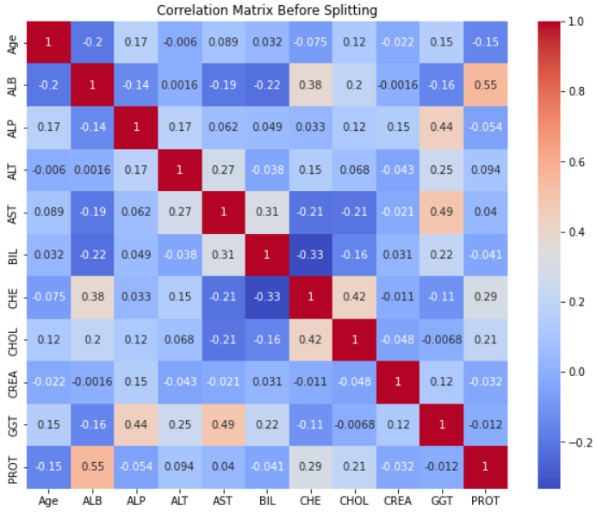
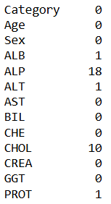
Introduction II. Data cleaning IV. First models application VI. Features selection
I. Data description III. Data preprocessing V. Grid search application Conclusion
Numerical Missing values: 40

Slide 6
Introduction II. Data cleaning IV. First models application VI. Features selection
I. Data description III. Data preprocessing V. Grid search application Conclusion
Column Transformer
Numerical Data
Categorical Data
Replace the missing data with the mean
Standardize the data
Replace the missing data with the most frequent
Apply the One-Hot-Encoder (‘Sex’ feature)
Split:
-Train
-Test
Fit the columns transformation

Slide 7
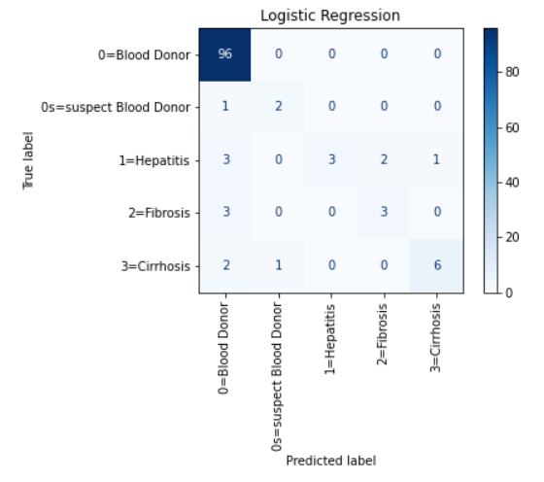
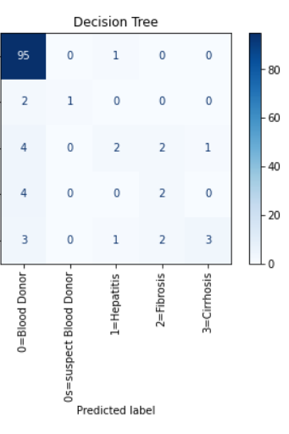
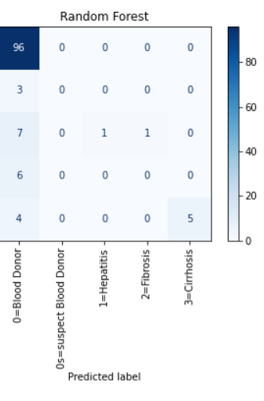
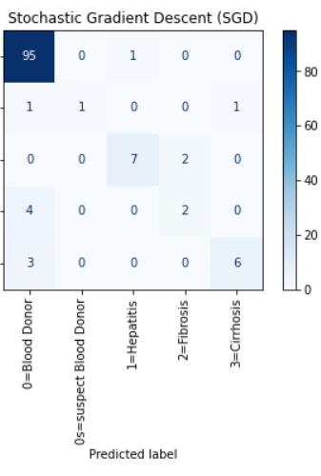
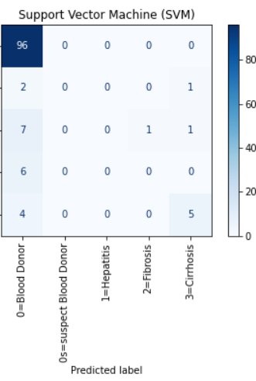
Introduction II. Data cleaning IV. First models application VI. Features selection
I. Data description III. Data preprocessing V. Grid search application Conclusion
Model | Logistic Regression | Decision Tree | Random Forest | SGD | SVM
Hyperparameters | random_state=42, max_iter=100 | Default parameters | n_estimators=10, max_depth=4 | max_iter=1000, tol=1e-3 (ie. Stopping criterion), random_state=42 | C= 1, gamma= 0.01, kernel= 'rbf', random_state=42
Accuracy | 0.8943089430 | 0.8373983739 | 0.8292682926 | 0.90243902439 | 0.82113821138

Slide 8
Introduction II. Data cleaning IV. First models application VI. Features selection
I. Data description III. Data preprocessing V. Grid search application Conclusion
Grid search is a method used in machine learning to systematically explore hyperparameter combinations to find the best model performance.
1
Grid search exhaustively evaluates hyperparameter combinations to optimize model performance, selecting the highest performing combination based on chosen metrics.
Common evaluation metrics include accuracy, precision, recall, F1-score, and AUC.
3
It's crucial for fine-tuning models and commonly used with cross-validation to ensure robustness and prevent overfitting.
2
However, grid search can be computationally expensive, particularly with large parameter grids and complex models.
4

Slide 9
Introduction II. Data cleaning IV. First models application VI. Features selection
I. Data description III. Data preprocessing V. Grid search application Conclusion
HYPER PARAMETER
1
random_state: Seed for random number generation to ensure reproducibility.
C: Regularization parameter controlling model complexity in SVMs and logistic regression.
3
max_iter: Maximum number of iterations for optimization algorithms.
2
criterion: Quality measure for splitting nodes in decision trees.
4
n_estimators: Number of trees in ensemble methods like Random Forests.
5
max_depth: Maximum depth of decision trees to prevent overfitting.
6
Gamma: Parameter controlling the influence of individual training samples in SVMs.
7
alpha: Regularization parameter in models like Lasso and Ridge regression.
8
loss: Loss function used for optimization in gradient boosting.
9

Slide 10
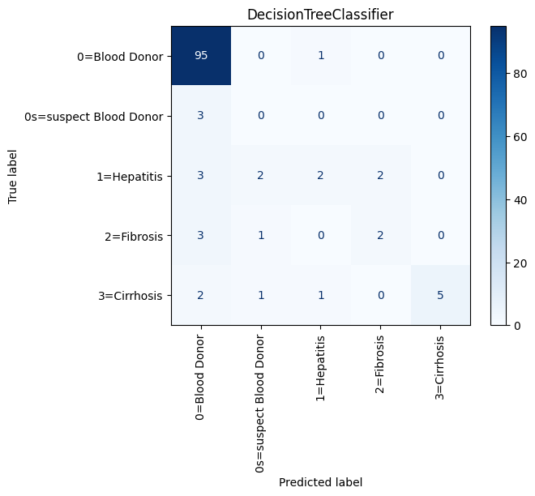
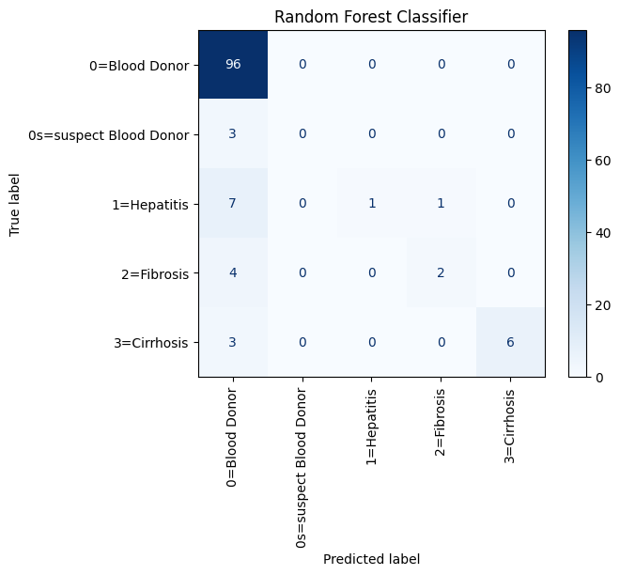
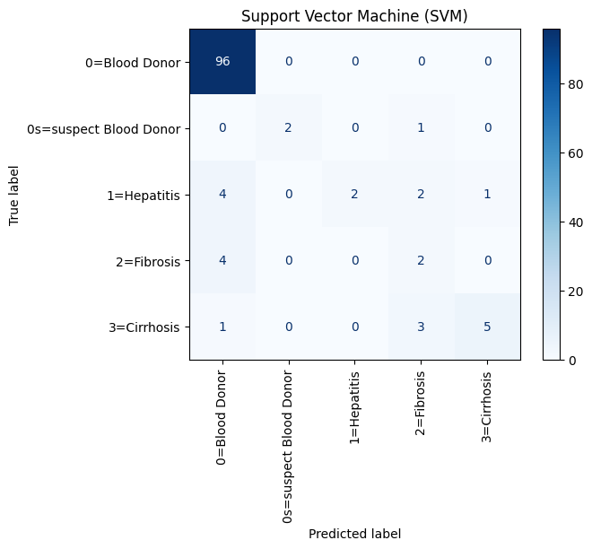
Introduction II. Data cleaning IV. First models application VI. Features selection
I. Data description III. Data preprocessing V. Grid search application Conclusion
 | LRM | DTM | RFM | SGDM | SVMM
Default | 89.43 | 86.17 | 85.36 | 86.99 | 81.30
Grid Search | 89.43 | 87.80 | 86.17 | 86.99 | 86.99

Slide 11
Introduction II. Data cleaning IV. First models application VI. Features selection
I. Data description III. Data preprocessing V. Grid search application Conclusion
Features selectors:
Pearson
Chi-Square
Recursive Feature Elimination (RFE)
Logistic Regression (log-reg)
Random Forest (RF)
Light Gradient Boosting Machine (LGBM)

Slide 12
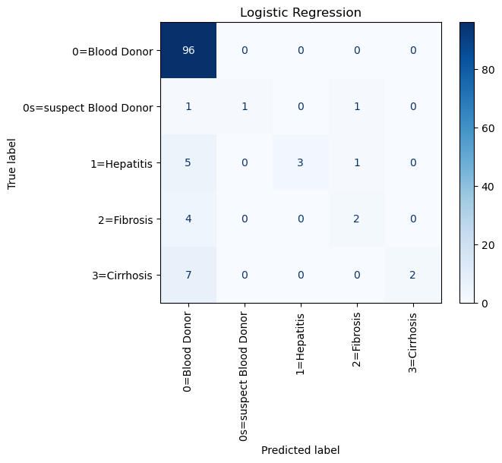
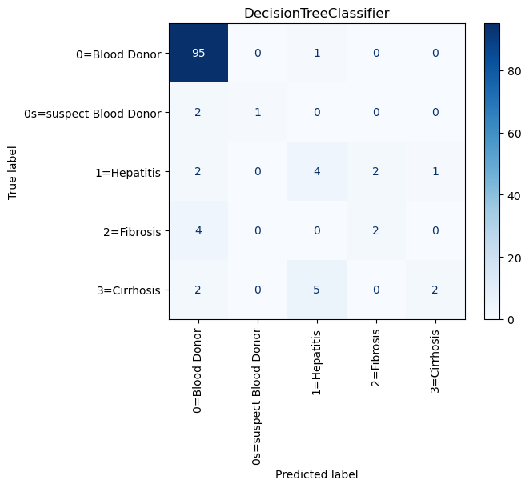
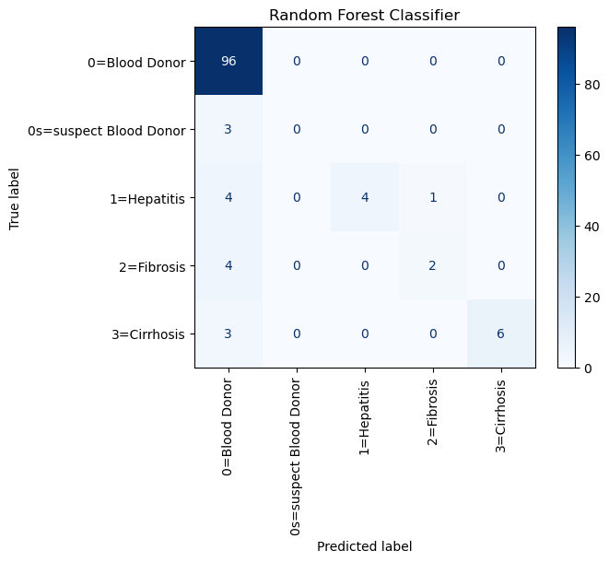
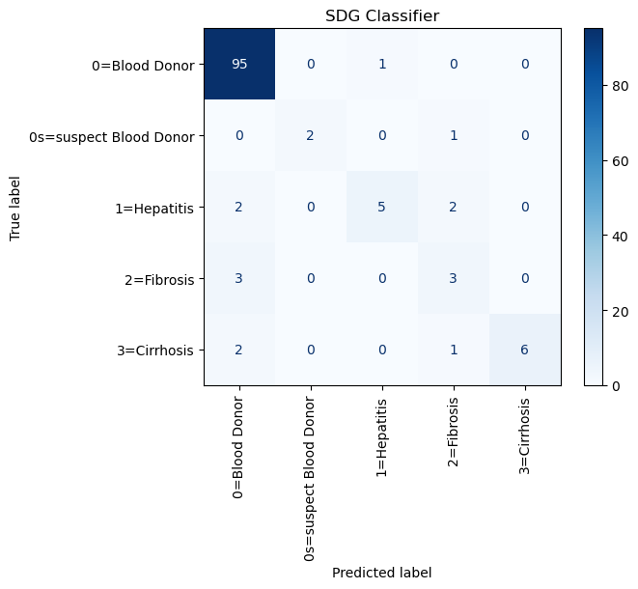
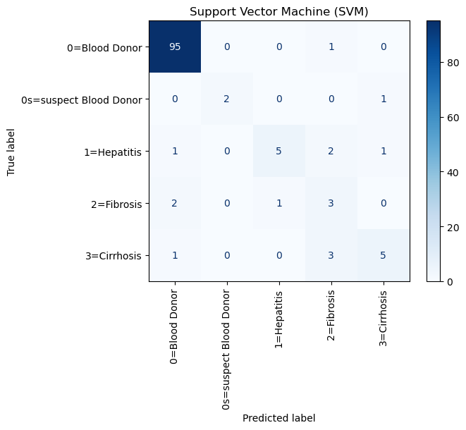
Introduction II. Data cleaning IV. First models application VI. Features selection
I. Data description III. Data preprocessing V. Grid search application Conclusion
 | Default | Grid search | No sex | No (sex – ggt) | No (sex – ggt – chol) | No (sex – ggt – chol - bil)
LRM | 89.43 | 89.43 | 88.61 | 89.46 | 85.37 | 86.99
DTM | 87.80 | 87.80 | 85.37 | 81.30 | 82.11 | 82.11
RFM | 86.18 | 85.37 | 85.37 | 86.18 | 86.99 | 86.18
SGDM | 86.99 | 87.80 | 89.43 | 83.74 | 83.74 | 83.74
SVMM | 86.99 | 86.99 | 89.43 | 83.74 | 88.62 | 85.37

Slide 13
Introduction II. Data cleaning IV. First models application VI. Features selection
I. Data description III. Data preprocessing V. Grid search application Conclusion

Slide 14
Introduction II. Data cleaning IV. First models application VI. Features selection
I. Data description III. Data preprocessing V. Grid search application Conclusion
What’s next:
- Remove unnecessary parameters to improve the grid search functionality
Improve model functionality through (max_iter, )
Retrieve more data as 600 is no where near enough
There could be more features that aren’t accounted for in this dataset

